Slide 1
Cooling Load Profile
JOHN JAY COLLEGE
04/23/2014
By: Nelson Valencia, Intern

Slide 2
JOHN JAY – CASE STUDY
Building Name: John Jay College New Expansion Building
Building Information: Separated into two sections: Tower (L3 to 10 floor) and Atrium (L3 to 1 Floor).
HVAC Equipment Inventory:
  Chilled Water loop: 3 chillers
  Hot Water loop: 3 Heat Exchangers & Perimeter Heating
  Air system – Six ACS: Three of them serving the north side and the rest the south side.
Focus: Load Profile (Chillers 1 – 3).
Interval Data Collection Time: 15 minutes

Slide 3
COOLING LOAD PROFILE
Sensors used in the development of the cooling load profile:
JJCEX.CHLR.PH.01.CALC.TON
JJCEX.CHLR.PH.02.CALC.TON
JJCEX.CHLR.PH.03.CALC.TON
JJCEX.CHLR.PH.SCHWS.FLOW
JJCEX.AHU.06.01.OAT

Slide 4
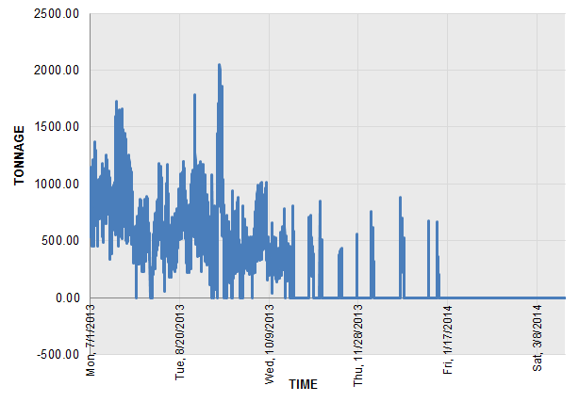
Sum of Calc Ton of the three Chillers
Date Range:
Jul/2013 – Mar/2014
Highest peak demand 2050 ton,
at Wed 12:30 pm, Sep/11/13
Fig 1. Time vs Tonnage.
This load profile illustrates the contribution of the cooling plant (Three Chillers).

Slide 5
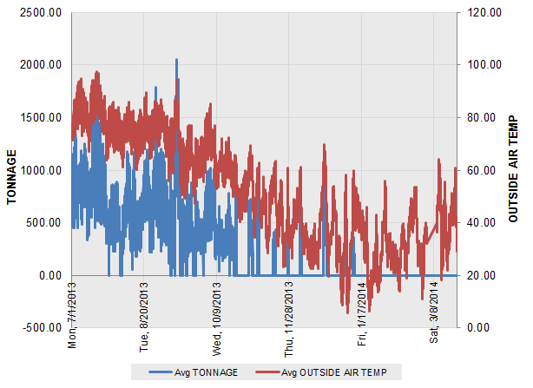
Sum of Calc Ton of the three Chillers
Date Range:
Jul/2013 – Mar/2014
Fig 2. Time vs Tonnage & Outside Air Temp (F).
From July until the first days of October, there is a good relationship between cooling load
and outside air temp. The building cooling load varies as a function of the outside air temp.

Slide 6
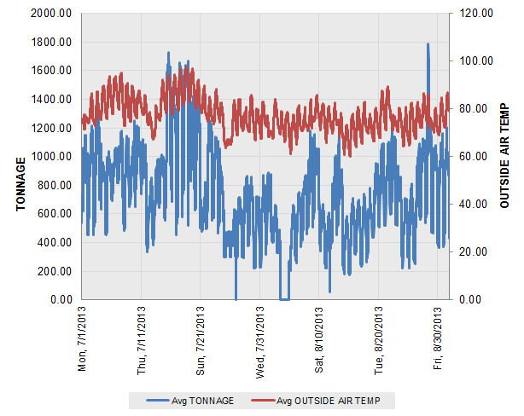
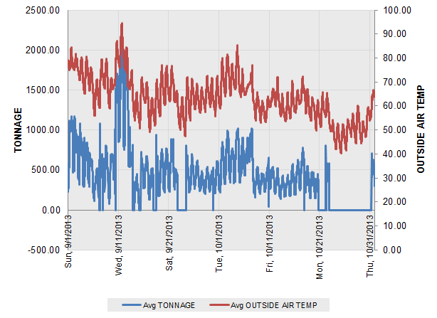
Sum of Calc Ton of the three Chillers
July – August / 2013
September – October /2013
Fig 3. Time vs Tonnage & Outside air temp.
Cooling load profile by two-months.

Slide 7
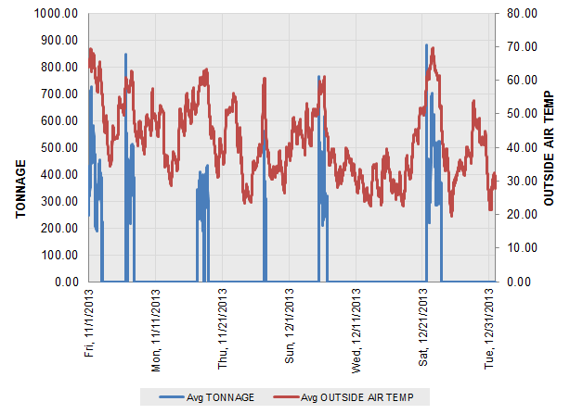
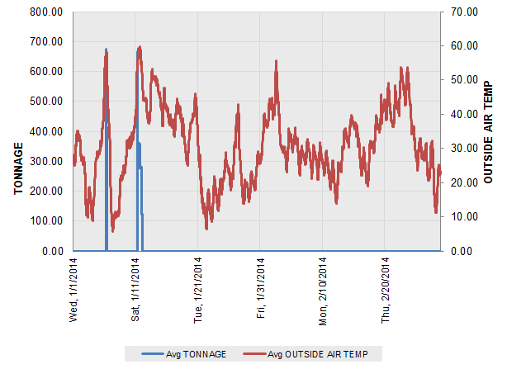
Sum of Calc Ton of the three Chillers
November – December / 2013
January – February /2014
Fig 4. Time vs Tonnage & Outside air temp.
Cooling load profile by two-months.
Notes:
For chiller and secondary pumps, there is not any scheduling strategy implemented, because in typical operation always there is one chiller and secondary pump working. Regardless if it is weekday or weekend. (NOTE: FOR THE ANALYSIS OF CHILLERS AND SECONDARY PUMPS, WE ANALYZED COLUMBUS DAY WEEKEND/HOLIDAY IN MONDAY OCT 14, COLLEGE IS CLOSED)

Slide 8
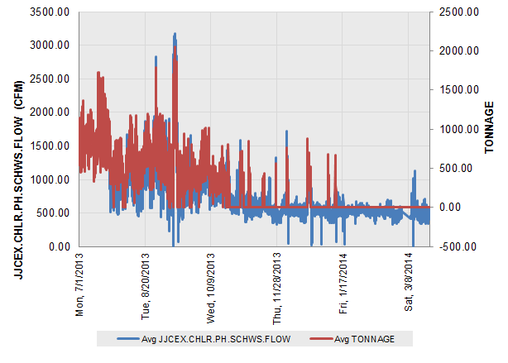
Sum of Calc Ton of the three Chillers
Date Range:
Jul/2013 – Mar/2014
Fig 5. Time vs Tonnage & SCHWS Flow (CFM).
.

Slide 9
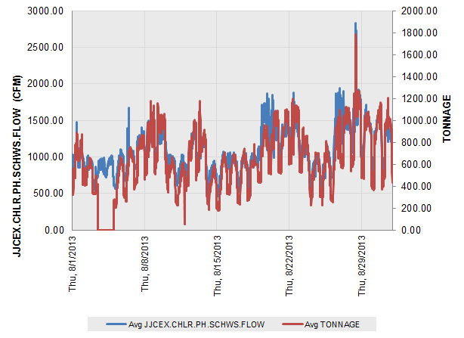
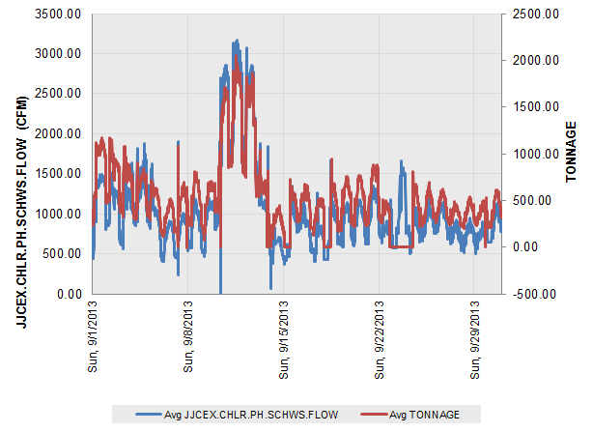
Sum of Calc Ton of the three Chillers
August / 2013
September /2013
Fig 6. Time vs Tonnage & & SCHWS Flow (CFM).
Cooling load profile by month.

Slide 10
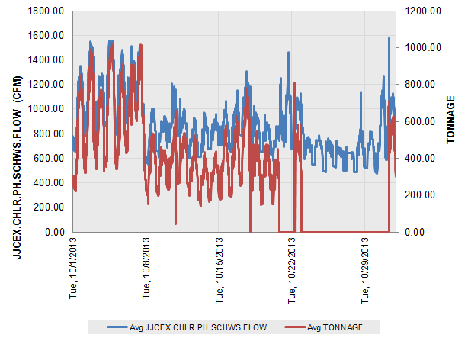
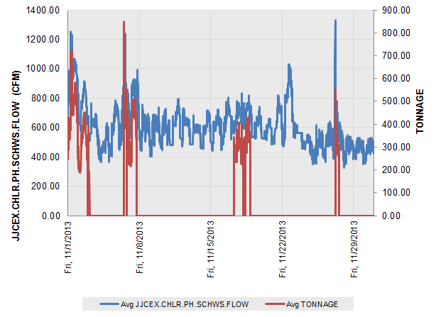
Sum of Calc Ton of the three Chillers
October / 2013
November /2013
Fig 7. Time vs Tonnage & SCHWS Flow (CFM).
Cooling load profile by month.

Slide 11
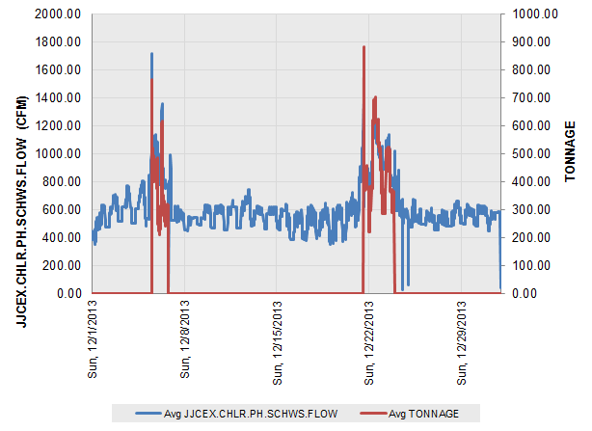
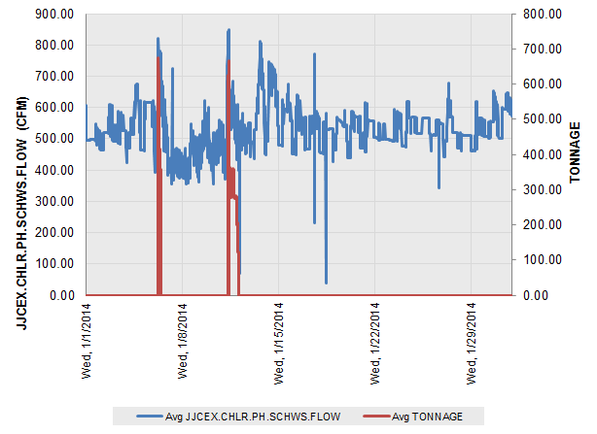
Sum of Calc Ton of the three Chillers
December / 2013
January /2014
Fig 8. Time vs Tonnage & SCHWS Flow (CFM).
Cooling load profile by month.

Slide 12
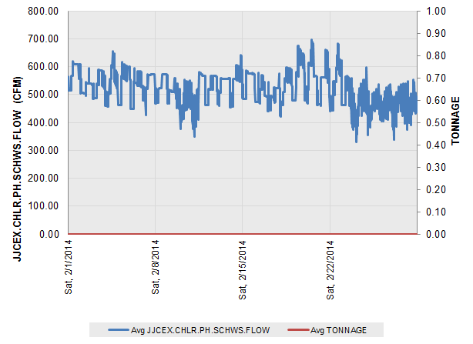
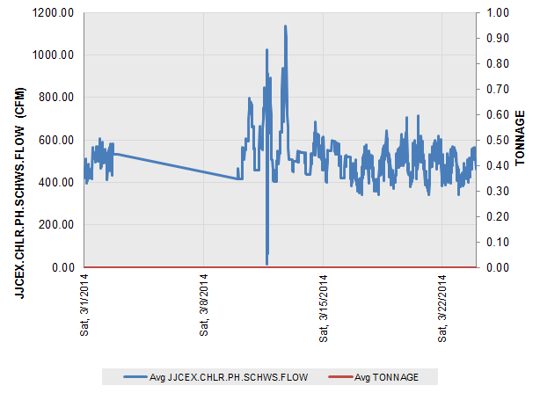
Sum of Calc Ton of the three Chillers
February / 2014
March /2014
Fig 8. Time vs Tonnage & SCHWS Flow (CFM).
Cooling load profile by month.

Slide 13
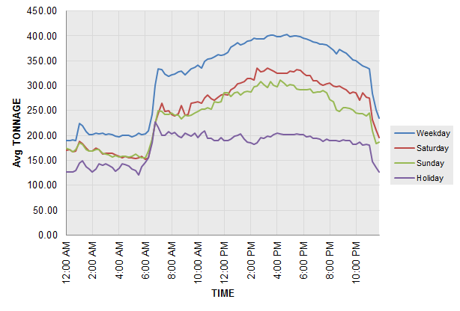
Sum of Calc Ton of the three Chillers
Date Range:
Jul/2013 – Mar/2014
Fig 9. Cooling Load Profile by Day Type.
The highest demand of tonnage are during weekdays because the level of building occupancy are greater in those days than weekends.

Slide 14
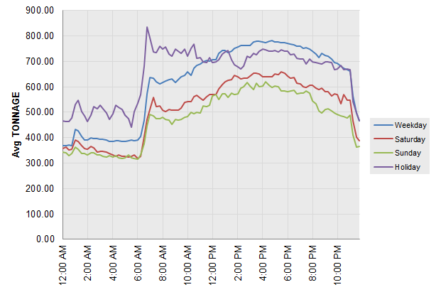
Sum of Calc Ton of the three Chillers
Date Range:
Jul/2013 – Oct/2013
Fig 10. Cooling Load Profile by Day Type.
The highest demand of tonnage are during weekdays because the level of building occupancy are greater in those days than weekends.

Slide 15
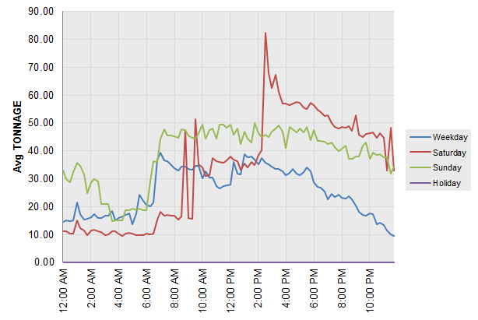
Sum of Calc Ton of the three Chillers
Date Range:
Nov/2013 – Mar/2014
Fig 11. Cooling Load Profile by Day Type.

Slide 16
COOLING LOAD PROFILE
FINDINGS:
The Highest peak demand during the summer in 2013 was 2050.46 Ton
During the summer there is a good correlation between outside air temperature and the cooling load.
The highest demand of cooling were during weekdays.
From November/2013 to March/2014 most of the time the chillers were off. During that period, the HVAC system probably operated in economizer mode.

